Slide 1
Chap#4
Development Life Cycle

Slide 2
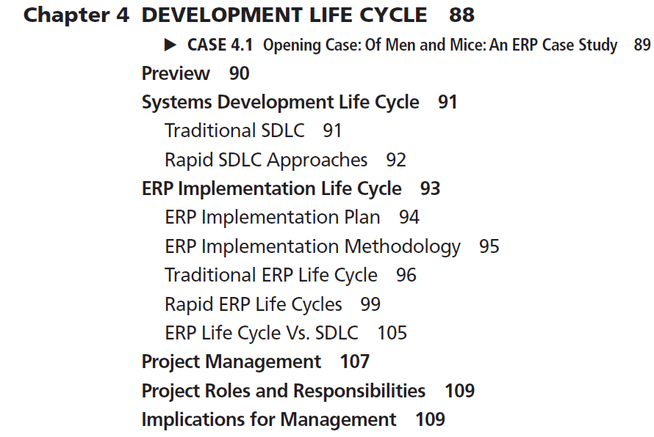

Slide 3
SYSTEMS DEVELOPMENT LIFE CYCLE
The process of developing new information systems is often called the system development life cycle.
Systematic process of planning, designing, and creating an information system for organizations.
For complex systems development projects (e.g., ERP), it is often better to have a structured methodology to avoid mishaps and coordinate the design and development tasks properly among the members of a large systems development team.
SDLC uses a systems approach for problem solving that basically states that complex problems need to be broken up into smaller manageable problems using a systems’ hierarchy, and then developing a solution for each problem within the hierarchy.
top-down problem identification and bottom-up solution process for managing complex problems.
SDLC process requires both technical and nontechnical problem-solving skills
variations that need to be accurately captured and processed by the new system
wide variety of IT and business skills for the project to be successful

Slide 4
Traditional SDLC
Reasons for the early failures, chief among them being lack of experience. This led to the systems approach, which we described earlier, and a structured SDLC methodology.
FIGURE 4-1 Traditional SDLC Methodology
FIGURE 4-2 SDLC Approach

Slide 5
Rapid SDLC Approaches
The SDLC process has several problems, even though it is rigorous in making sure that the new system is complete and successful in the organization.
developing a new system is time consuming and tedious
In many cases the new system is outdated by the time it is developed
cost associated with the SDLC process is very high
cost of recruiting
SDLC would be overkill for a small-scale decision-making application; therefore, over the years organizations have used rapid approaches to SDLC that are quicker and less expensive shortcuts to this process. These are called Rapid SDLC approaches.
One rapid development approach is prototyping. This approach does not go through the analysis and design phases; instead, it implements a skeleton or a prototype of the actual system with a focus on input (i.e., user interface) and output (i.e., screen displays and reports generated with dummy data). The idea is to demonstrate the system functionality as soon as possible to the users and to get their feedback on the prototype.
ERP sandboxes replicate at least the minimal functionality needed to get user feedback before implementing a full-scale system. The goal of sandboxing is similar to that of prototyping (personal computers, trained staff).
EUD is applicable in ERP for designing custom reports from the ERP system.

Slide 6
ERP IMPLEMENTATION LIFE CYCLE
ERP applications are prepackaged software developed by commercial software vendors and custom installed for organizations to automate and integrate the various business processes.
complex software packages costing millions of dollars
applications are mission critical (i.e., if they fail or break down, the organization will stop functioning).
ERP systems can be deployed in a big bang or phased approach, either of which initiates the stages of a system development life cycle.
According to the staged system implementation model,1 the life cycle consists of four phases—adaptation(system investigation), acceptance(system analysis), routinization (customization), and infusion(maintenance).

Slide 7
ERP Implementation Plan
An ERP implementation plan is used to create a roadmap or blueprint to meet cost, scope, and time constraints of an implementation. Following are three major implementation plan choices:
Following are three major implementation plan choices:
Comprehensive. A comprehensive ERP integration plan is the most expensive, lengthy, and costly approach. It involves implementation of the full functionality of the ERP software in addition to industry-specific modules.
Middle of the Road. A middle-of-the-road ERP implementation plan involves some changes in the core ERP modules and a significant amount of BPR. The middle-of-the-road approach is not as expensive.
3. Vanilla. A vanilla ERP implementation plan utilizes core ERP functionality and exploits the best practice business processes built into the software. Align their business processes to the ERP system.By eliminating or minimizing the required BPR, the project’s costs and time required for the implementation are minimized.

Slide 8
ERP Implementation Methodology
Methodology refers to a systematic approach to solving a business problem.
Enterprise can maximize its returns by maximizing the utilization of its fixed supply of resources.
Like SDLC, an ERP development life cycle provides a systematic approach to implementing ERP software in the changing but limited-resource organizational environment.
The traditional ERP life cycle accomplishes one stage at a time and requires formal milestone approvals prior to moving to the next stage.
In a rapid ERP life cycle, once a company commits to the implementation, employees are empowered to make the decisions to keep the project moving forward. They also allow flexibility and quicker feedback loops to accommodate rapid corrections.

Slide 9
Traditional ERP Life Cycle
Traditional ERP life cycle approach has a deliverable at the end of each stage. Traditional ERP life cycle includes the following major stages:
Stage 1. Scope and commitment stage: investigation stage
Stage 2. Analysis and design stage: analysis of user requirements
Stage 3. Acquisition and development stage: acquisition and testing stage
Stage 4. Implementation stage:installing and releasing the system to the end users and monitoring
Stage 5. Operation stage: operation team with assistance from the implementation team
FIGURE 4-5 Traditional ERP Life Cycle
TABLE 4-2 List of Scopes and Commitments
FIGURE 4-6 ERP Conversion Approaches

Slide 10
ROLE OF CHANGE MANAGEMENT
A vision for CM needs to be articulated from the first stage and then revised, monitored, and implemented on a constant basis.
Guide the implementation team on all the activities of change management.
Support of the top management as well as skills of the change management team are essential for successful implementation.

Slide 11
Rapid ERP Life Cycles
Long requirements-gathering phase, followed by designs, and implementations.
Significant amounts of time
Businesses grow and move quickly(requirement changes)
use of experienced consultants
high commitment of resources
FIGURE 4-7 ERP Life Cycle Phases Summary
TOTAL SOLUTION: Highly integrated, demand cross-functional collaboration, and require significant change management. The Total Solution approach has five components:
1. The value proposition: Building the sound business sense
2. Reality check. Assessing an organization’s readiness for change
3. Aligned approach. Setting the right expectations that deliver both short-term and long-term value.
4. Success dimension. Getting the right blend of people, skills, methods, and management in the team.
5. Delivering value. Measuring results and celebrating success.

Slide 12
FASTTRACK: Enhance and accelerate ERP software implementations. Matrix of five phases:
Stage 1. Scoping and planning
Stage 2. Visioning and targeting
Stage 3. Redesign: To-be Modeling
Stage 4. Configuration
Stage 5. Testing and delivery
Matrix of five focus areas:
Stage 1. Project management
Stage 2. Information technology architecture
Stage 3. Process and systems integrity
Stage 4. Change leadership
Stage 5. Training and documentation
Rapid-Re: customized to the needs of each project
Stage 1. Preparation
Stage 2. Identification
Stage 3. Vision
Stage 4. Solution
Stage 5. Transformation

Slide 13
ACCELERATED SAP (ASAP) The ASAP roadmap is a detailed project plan by SAP that describes all activities in an implementation. The ASAP roadmap consists of five phases:
Phase 1.Project preparation
Phase 2. Business blueprint
Phase 3.Realization
Phase 4.Final preparation
Phase 5. Go-live and support

Slide 14
BUSINESS INTEGRATION METHODOLOGY (BIM)
Targeted for full-scale ERP projects that diagnose business integration needs,design business strategies and architectures, deliver one or more business capabilities to meet those needs, and ensure that the value of those capabilities can be sustained over time.
Strategic planning, delivery, and operation of technologies, processes, facilities, and human performance.
To achieve business integration Team must define and implement a comprehensive set of changes to an organization, spanning improvements to business processes,technology, and human performance, all aligned with an organization’s overall strategy.
custom-built solutions or a blend of custom and packaged components
Following Phases includes:
The planning phase
The delivering phase
The managing phase
The operating phase

Slide 15
AGILE DEVELOPMENT
At the core of any agile approach is an assumption that whatever the requirements might be at the beginning of a project, they won’t be the same at the end of the project.The longer the project, the more truth there is in this assumption. To mitigate this situation, agile methodologies start with smaller sets of requirements, they start small and deliver functionality incrementally in a series of releases. No single release covers all requirements, but every release delivers more than the previous one.
Popular for Traditional Software Development
Agile methodology tries to solve is changing and unclear requirements.
An agile methodology has many different types of implementations. Two of the most popular implementations are Scrum and extreme programming (XP).
Waterfall Model implementation, if the first requirement implemented is wrong, an entire ERP system could be implemented upon that basis.
In Scrum, the methodology states the following: “Instead of providing complete, detailed descriptions of how everything is to be done on the project, much is left up to the team. This is done because the team will know best how to solve its problem.”
Scrum methodology works in an agile iterative methodology empowers the team (including a Scrum master, product owner, and team members) to make decisions that will help deliver a successful product deliverable.
“Extreme Programming (XP) is successful because it stresses customer satisfaction.
In XP, an agile iterative approach is valued because it gives working software to the customers quickly and incorporates their feedback quickly to build the best product possible.

Slide 16
ERP Life Cycle Vs. SDLC
Table 4-3
key differences and similarities between the ERP life cycle and SDLC mentioned below

Slide 17
PROJECT MANAGEMENT
ERP projects take on their own organizational duties and job functions separate and apart from the day-to-day business functions.
A clear project plan and reporting structure will better ensure that the project receives the attention and accountability needed to be successful.
Organizational structure must coincide with the project governance(hierarchy)
ERP implementation project organizations are created just for the project; however, this is changing.
Levels of hierarchy defined next.

Slide 18
PROJECT ROLES AND RESPONSIBILITIES
Identifying and describing roles and responsibilities for project staff is necessary to ensure there is accountability within the project.
variety of people from different parts of the organization along with external staffing (consultants).
Defining roles, often used as job descriptions on a project, will be the responsibility of the project management office.
Each member of the project team will need to know what is expected of them, who they will report to, and what they will be evaluated on.

Slide 19
IMPLICATIONS FOR MANAGEMENT
First and foremost, it is critical to have solid top management commitment.
Given the complexities of ERP implementations, it is also important to have strong and experienced program management.
In order to reduce the chances of unexpected and unpleasant surprises, it is a good heuristic to minimize the type and number of customizations that are implemented.
Along with the actual implementation, it is critical to emphasize training and change management.
Table 4-4

